Slide 1
Event Handling

Slide 2
Event Handling in Swing
Java’s Event handling is covered by java.awt.event.
There are two mechanisms for handling events.
The way in which events are handled changed significantly between the original version of Java (1.0) and all subsequent versions of Java, beginning with version 1.1.
The modern approach is the way that events should be handled by all new programs and thus will be the method employed by our programs.

Slide 3
The Delegation Event Model
The modern approach to handling events is based on the delegation event model, which defines standard and consistent mechanisms to generate and process events.
Its concept is quite simple: a source generates an event and sends it to one or more listeners.
The listener simply waits until it receives an event.
Once an event is received, the listener processes the event and then returns.
The advantage of this design is that the application logic that processes events is cleanly separated from the user interface logic that generates those events. A user interface element is able to “delegate” the processing of an event to a separate piece of code.

Slide 4
Events
An event is an object that describes a state change in a source.
Among other causes, an event can be generated as a consequence of a person interacting with the elements in a graphical user interface.
Some of the activities that cause events to be generated are pressing a button, entering a character via the keyboard, selecting an item in a list, and clicking the mouse.
The event object contains whatever properties are pertinent to the event.

Slide 5
Event Sources
A source is an object that generates an event. This occurs when the internal state of that object changes in some way. Sources may generate more than one type of event.
A source must register listeners in order for the listeners to receive notifications about a specific type of event. Each type of event has its own registration method. Here is the general form:
public void addTypeListener (TypeListener el )

Slide 6
Discussion of Event Sources
Type is the name of the event, and el is a reference to the event listener.
For example, the method that registers a keyboard event listener is called addKeyListener( ).
The method that registers a mouse motion listener is called addMouseMotionListener( ).
When an event occurs, all registered listeners are notified and receive a copy of the event object. This is known as multicasting the event. In all cases, notifications are sent only to listeners that register to receive them.
A source must also provide a method that allows a listener to unregister an interest in a specific type of event. The general form of such a method is this:
public void removeTypeListener(TypeListener el )

Slide 7
Event Listeners
A listener is an object that is notified when an event occurs. It has two major requirements.
First, it must have been registered with one or more sources to receive notifications about specific types of events.
Second, it must implement methods to receive and process these notifications. In other words, the listener must supply the event handlers.
The methods that receive and process events are defined in a set of interfaces, such as those found in java.awt.event.
For example, the ActionListener interface defines a method to receive notifications when a button is pressed. Any object may handle this event by providing an implementation of this interface.

Slide 8
Event classes
The most widely used events are those defined by the AWT and those defined by Swing.
At the root of the Java event class hierarchy is EventObject, which is in java.util. It is the superclass for all events. Its one constructor is shown here: EventObject(Object src)
Here, src is the object that generates this event.
EventObject defines two methods: getSource( ) and toString( ). The getSource( ) method returns the source of the event. Its general form is shown here: Object getSource( )
The toString( ) method returns the string equivalent of the event.
The class AWTEvent, defined within the java.awt package, is a subclass of EventObject.

Slide 9
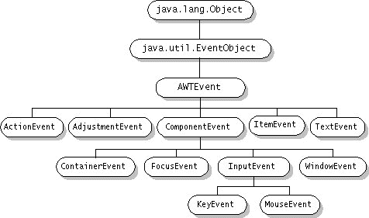

Slide 10
Listener Classes and Interfaces
Each listener class implements a listener interface.
The Java listener interfaces are in the java.awt.event and javax.swing.event packages.
Listener interfaces specify one or more abstract methods that must be implemented by the listener class.
The listener methods receive as a parameter an event object, which represents the event fired.

Slide 11
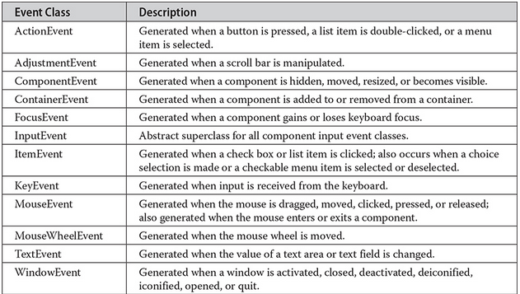
Event Classes and their Descriptions

Slide 12
The Action Event Class
The most common event is the Action Event. It is generated when a button is pressed, a list item is double-clicked, or a menu item is selected.
There are lots of other events, specific to the objects that generate them.
The event object contains properties are pertinent to the event.

Slide 13
Sources of Events and Listeners
JComponent | Event Generator | Event Object Created | Listener Interface
JTextField | Pressing Enter | ActionEvent | ActionListener
JButton | Pressing the button | ActionEvent | ActionListener
JRadioButton | Selecting a Radio Button | ItemEvent | ItemListener
JCheckBox | Selecting or de-selecting a check box | ItemEvent | ItemListener
JComboBox | Selecting an item | ItemEvent | ItemListener
JList | Selecting an item | ListSelectionEvent | ListSelectionListener
Any Component | Pressing or releasing mouse buttons | MouseEvent | MouseListener
Any Component | Moving or dragging the mouse | MouseEvent | MouseMotionListener

Slide 14
To Handle User Input for a GUI Component
1. Write an event handler class (also called a listener)
2. Instantiate an object of the class
3. Register the listener with one or more components.

Slide 15
1. Write the Listener or Event Handler Class
Since a listener is usually limited to listening to just one class, listeners are often implemented as inner classes.
An inner class can directly access its enclosing class's instance variables.
To further the goal of encapsulation, you can "hide" the inner class by declaring it with the private access modifier.
Example: A buttonClick
private class ButtonHandler implements ActionListener {
@Override
public void actionPerformed(ActionEvent e) {
<do something>
}
}

Slide 16
2. Instantiate an object of the Class. 3. Register your listener object with the component that is firing the event.
Button myButton = new Button(); // instantiate the component object
2. ButtonHandler handler = new ButtonHandler();
2a. Or use an Anonymous object of the ButtonHandler class
3. button.addActionListener(handler);
3.a. Pass the anonymous handler object:
button.addActionListener(new ButtonHandler());

Slide 17

Source of the Event
How to determine which button fired the event by using the getSource() method of the Event class.
For Example, in this Simple Math Calculator, the user enters a number and then selects a button to either calculate the sqrt of x or log 10 of x.
A single listener class is created, named Listener.
An object of the class is added as an ActionListener to both button objects. Here is the code for the Listener class.

Slide 18
Code for the Simple Math Calculator Listener Class
private class Listener implements ActionListener {
public void actionPerformed(ActionEvent e) {
double x; // numeric value for user entered x
double result; // calculated value
if (e.getActionCommand().equals("sqrt x")) {//find square root
result = Math.sqrt(x);
xSqrtBox.setText(String.format("%7.5f", result));
} // end if
else // calculate logarithm {
result = Math.log10(x);
xLogBox.setText(String.format("%7.5f", result));
} // end else
} // end actionPerformed
} // end class Listener

Slide 19
What is an Action Command?
Java lets us specify an “action command” string for buttons (and other components, like menu items, that can generate action events).
The action command is just a String that serves to identify the component that sent the event.
By default, the action command of a JButton is the same as its label; it is included in action events so that you could use it to figure out which button an event came from.
However, you’ll often know this from the context of your event listener.

Slide 20
To Get the Action Command from an Action Event
Call the event’s getActionCommand() method
public void actionPerformed(ActionEvent e){
if (e.getActionCommand().equals(“Save File") {
//the user pressed the button that says “Save File”.
...
}
}

Slide 21
To Change the Action Command
You can change the action command by calling the button’s setActionCommand() method. The following code changes button myButton’s action command to “confirm:”
myButton.setActionCommand("confirm");

Slide 22
The getSource Method identifies which Component Initiated the Event
private JButton yayButton;
private JButton nayButton;
public void actionPerformed(ActionEvent event) {
if (event.getSource() == yayButton) {
println("Yay");
} else if (event.getSource() == nayButton) {
println("Nay");
}
}

Slide 23
Which to Use?
If you want the object name of the event source, use GetSource().
If you want the label of the object to compare it with another String, use getActionCommand().

Slide 25
Radio Buttons and Check Boxes
Selecting or deselecting radio buttons and checkboxes fire both an ItemEvent and an ActionEvent.
Radio Buttons must be included in a Button Group so that they will be mutually exclusive. That is, only one radio button can be selected at a time.
CheckBoxes can have multiple selections at one time.

Slide 26
Item Event
Inner class implements ItemListener interface
Interface method is itemStateChanged instead of actionPerformed.
The procedure is the same as for an Action Listener.

Slide 27
Anonymous Classes
An anonymous class is an inner class without a name.
An anonymous class is defined and instantiated in a single succinct expression using the new operator.
While a class definition is a statement in a block of Java code, an anonymous class definition is an expression, which means that it can be included as part of a larger expression, such as a method call.
Because an anonymous class has no name, it is not possible to define a constructor for it within the class body.
If your class requires a constructor, you must use an inner class instead. However, instance initializers were introduced into the language to substitute for a constructor.
You can only create one instance of this class.

Slide 28
When to use Anonymous Classes
Use if:
The class has no constructor or can use an instance initializer.
The class has a very short body.
Only one instance of the class is needed.
The class is used right after it is defined.
The name of the class does not make your code any easier to understand.

Slide 29
How we get there
//Class scope variable reference
private JButton jbtnCalc;
//Instantiate the JButton in the frame constructor
jbtnCalc = new JButton();
//We write an inner class to implement the interface
private class CalcBtnHandler implements ActionListener{
@Override
public void actionPerformed(ActionEvent e) {
System.out.println(“Thanks for listnening”);
}
}

Slide 30
Step 2
//Make an object of the class
CalcBtnHandler cbHandler = new CalcBtnHandler();
//Register the listener with the button
jbtnCalc.addActionListener(cbHandler);
That’s the long way. We can condense it one step by using an anonymous object for the listener object:
jbtnCalc.addActionListener(new CalcBtnHandler());
But we can do better. We need to combine the action of the new operator and the body of the class so we can still implement the interface.

Slide 31
Combine inner class with adding the anonymous listener object ➔ anonymous inner class
jbtnCalc.setActionListener(new class CalcBtnHandler
implements ActionListener(){
@Override
public void actionPerformed(ActionEvent e){
//System.out.println(“Thanks for listnening”);
} //end of actionPerformed
});

Slide 32
Step 3 – The Result
Combine the definition of an anonymous inner class with its usage and the registration of the listener in one block of code.
Instead of using the addActionListener method to attach an object of a class implementing the ActionListener interface, just define the implementation right there:
JButton jbtnCalc = new JButton();
jbtnCalc.addActionListener(new ActionListener(){
public void actionPerformed(ActionEvent e) {
//System.out.println(“Thanks for listening”);
}
}); //Here is the clue that we have an anonymous class

Slide 33
Here it is Broken Down
jbtnCalc.addActionListener(new ActionListener(){
public void actionPerformed(ActionEvent e) {
//list actions here
} //end of actionPerformed method
} //end of declaration of inner class
) //end argument list of .addActionListener
; //end the statement

Slide 34
Using a Lambda
JButton button = new JButton(“Click me!”);
button.addActionListener(ae -> System.out.println(“Thanks for listening!”));

